Slide 1
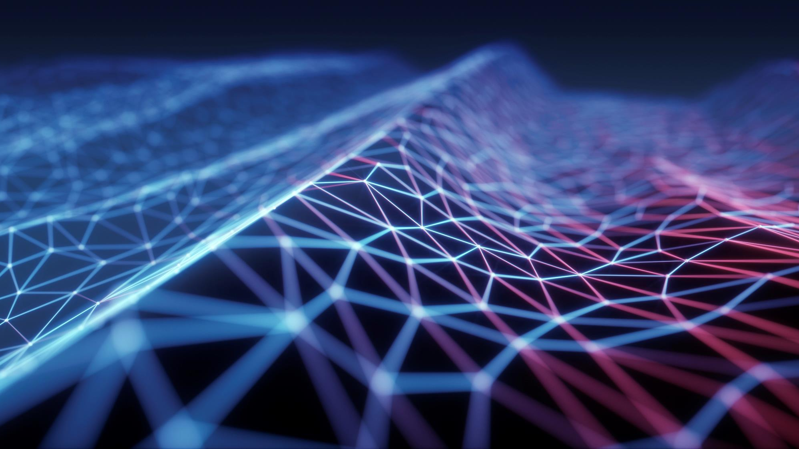
Iot - Based Automate infiltrometer
Guided by – dr. debanjan das sir

Slide 2
Group members
Student Name | Roll NO | Email
Bhavesh Balendra | 211010221 | bhavesh21101@iiitnr.edu.in
Neeraj Kumar Singh | 211010235 | neeraj21101@iiitnr.edu.in
Soumya Rayast | 211010248 | soumya21101@iiitnr.edu.in

Slide 3
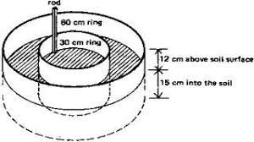
Double Ring INfiltrometer
The double ring infiltrometer is a simple instrument that is used to determine the rate of infiltration of water into the soil. The rate of infiltration is determined as the amount of water per surface area and time unit, that penetrates the soil. This rate can be calculated on the basis of the measuring results and the Law of Darcy. The standard set of the double ring infiltrometer consists of a number of sets of stainless steel rings with different diameters (for reasons of transportation). Several measurements can be executed simultaneously, yielding a very reliable and accurate mean result.As vertically infiltrated water runs away to the sides, the outer ring of the infiltrometer serves as a separation. The measurements exclusively take place in the inner ring through which the water runs virtually vertical.

Slide 4
Double Ring Infiltrometer
Problem’s Faced by using Double Ring Infiltrometer :
DRI takes more time and efforts to performed properly.
It’s required two operators for water level measurement.
Chance of human error and data loss.

Slide 5
Aim/Objective/motivation
To develop fully Automatic.
To develop a low-cost IoT device capable of measuring and cloud storing soil infiltration rate.
Show the data through applications with help of graph.
For helping farmer to get information regardind their land ,that how much soil absorbing water at what per hour.

Slide 6
Concept
We have build a automatic infiltrometer IoT device which can measure absorption of water level per unit time and send to an IoT cloud called Thingspeak where we can monitor the current level of water and absorption overtime. We have used fowlling component eps8266 microcontroller, ultrasonic sensor to measure water level precisely. Measuring water level is same as measuring distance of solid surfaces, the ultrasonic transducer outputs a train of ultrasonic bursts at 40 KHz which will hit the water surface and reflect back to the sensor. The time taken between sent and received ultrasonic waves are calculated by a microcontroller such as esp8266. The measured distance is converted in to percentage.
The tank has two heights the actual water holding capacity and the total height of the tank. In any overhead tank there will be overflow and inlet tube, the point just below the overflow tube is the end of water holding capacity. You need to measure these two heights and enter it in the given program code in centimetre.

Slide 7
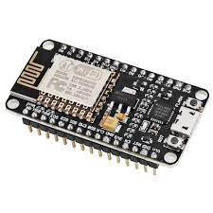
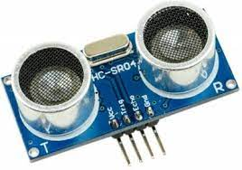
Components Requirements
ESP8266-
NODEMCU
NodeMCU is an open-source firmware and development kit that helps you to prototype or build IoT products. It includes firmware that runs on the ESP8266 Wi-Fi SoC from Espressif Systems, and hardware which is based on the ESP-12 module. The firmware uses the Lua scripting language.
Ultra Sonic Sensor
An ultrasonic sensor is an electronic device that measures the distance of a target object by emitting ultrasonic sound waves, and converts the reflected sound into an electrical signal. Ultrasonic waves travel faster than the speed of audible sound. Ultrasonic sensors have two main components: the transmitter and the receiver

Slide 8
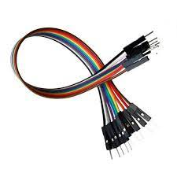
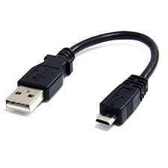
Jumper Wires
A jump wire is an electrical wire, or group of them in a cable, with a connector or pin at each end (or sometimes without them – simply "tinned"), which is normally used to interconnect the components of a breadboard or other prototype or test circuit, internally or with other equipment or components, without soldering
USB Cable
The term USB stands for "Universal Serial Bus". USB cable assemblies are some of the most popular cable types available, used mostly to connect computers to peripheral devices such as cameras, camcorders, printers, scanners, and more. Devices manufactured to the current USB Revision 3.0 specification are backward compatible with version 1.1.

Slide 9
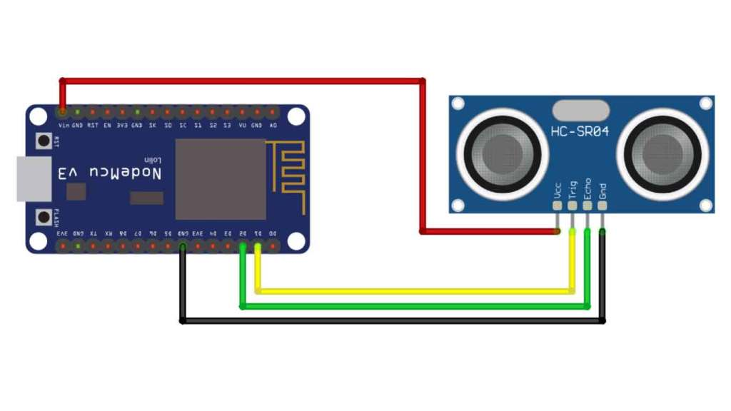

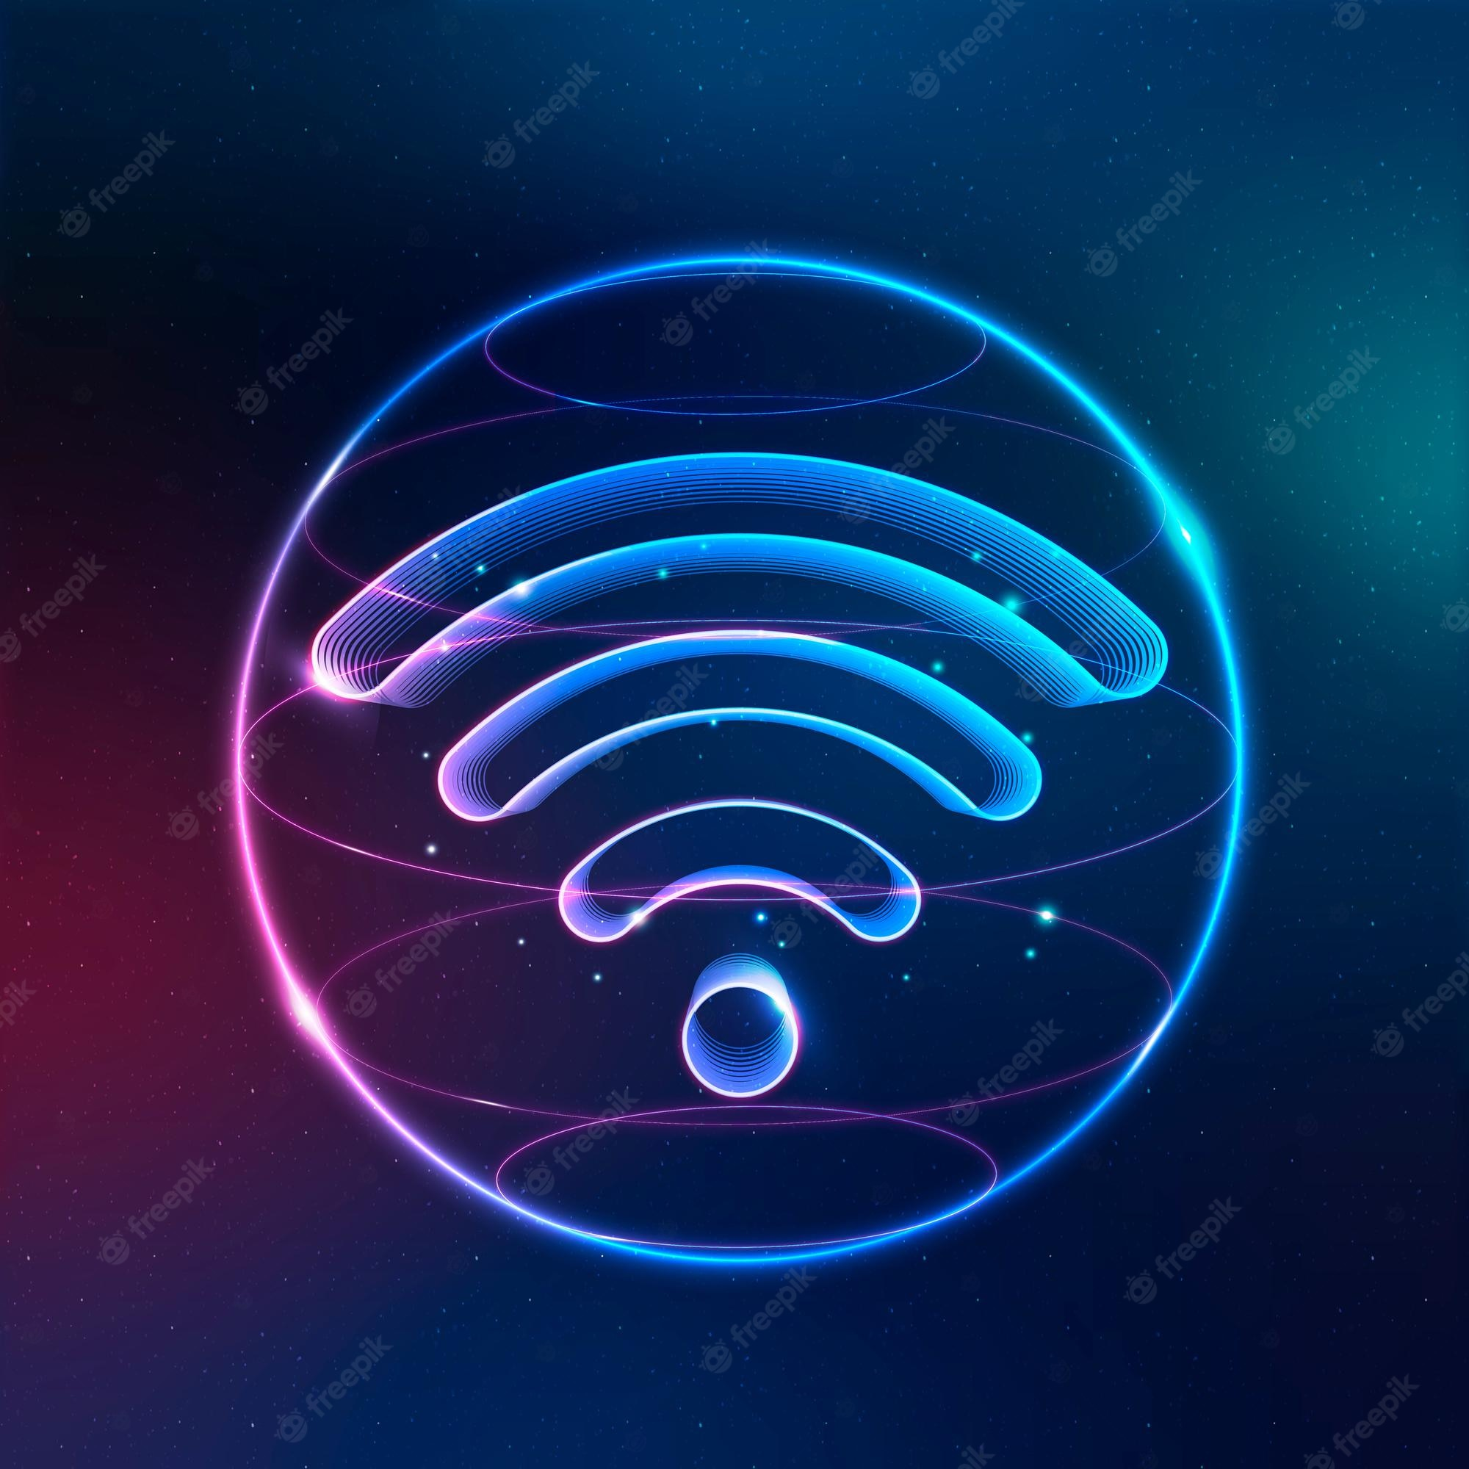
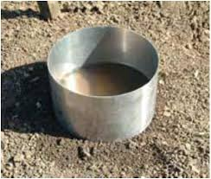
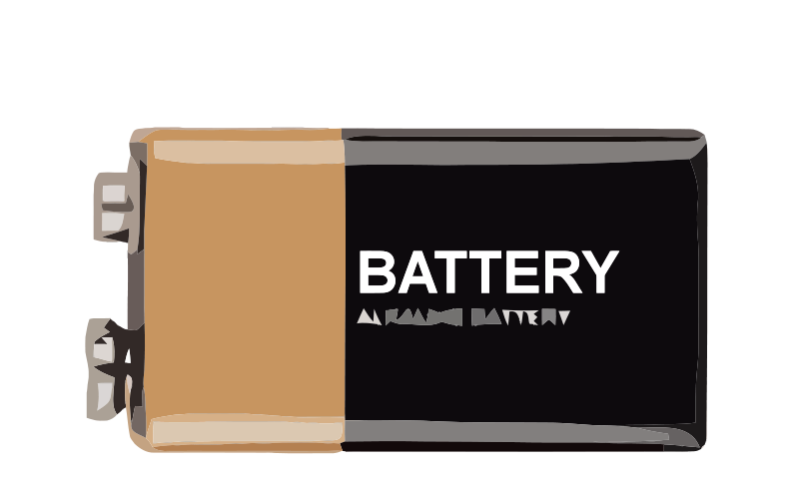
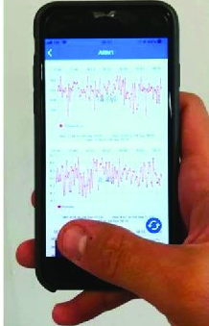
Sensor node component level

Slide 10
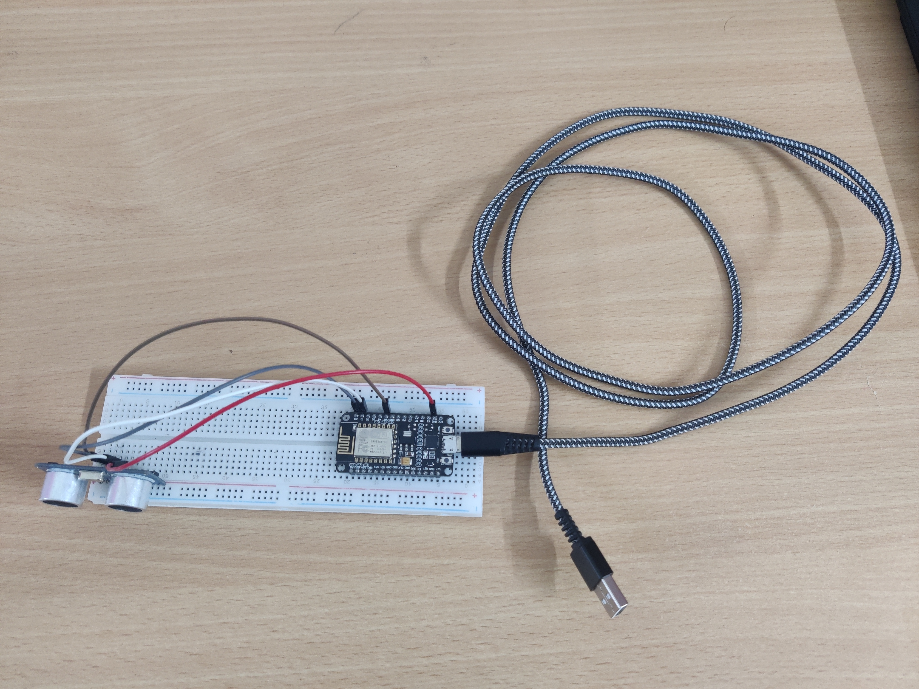
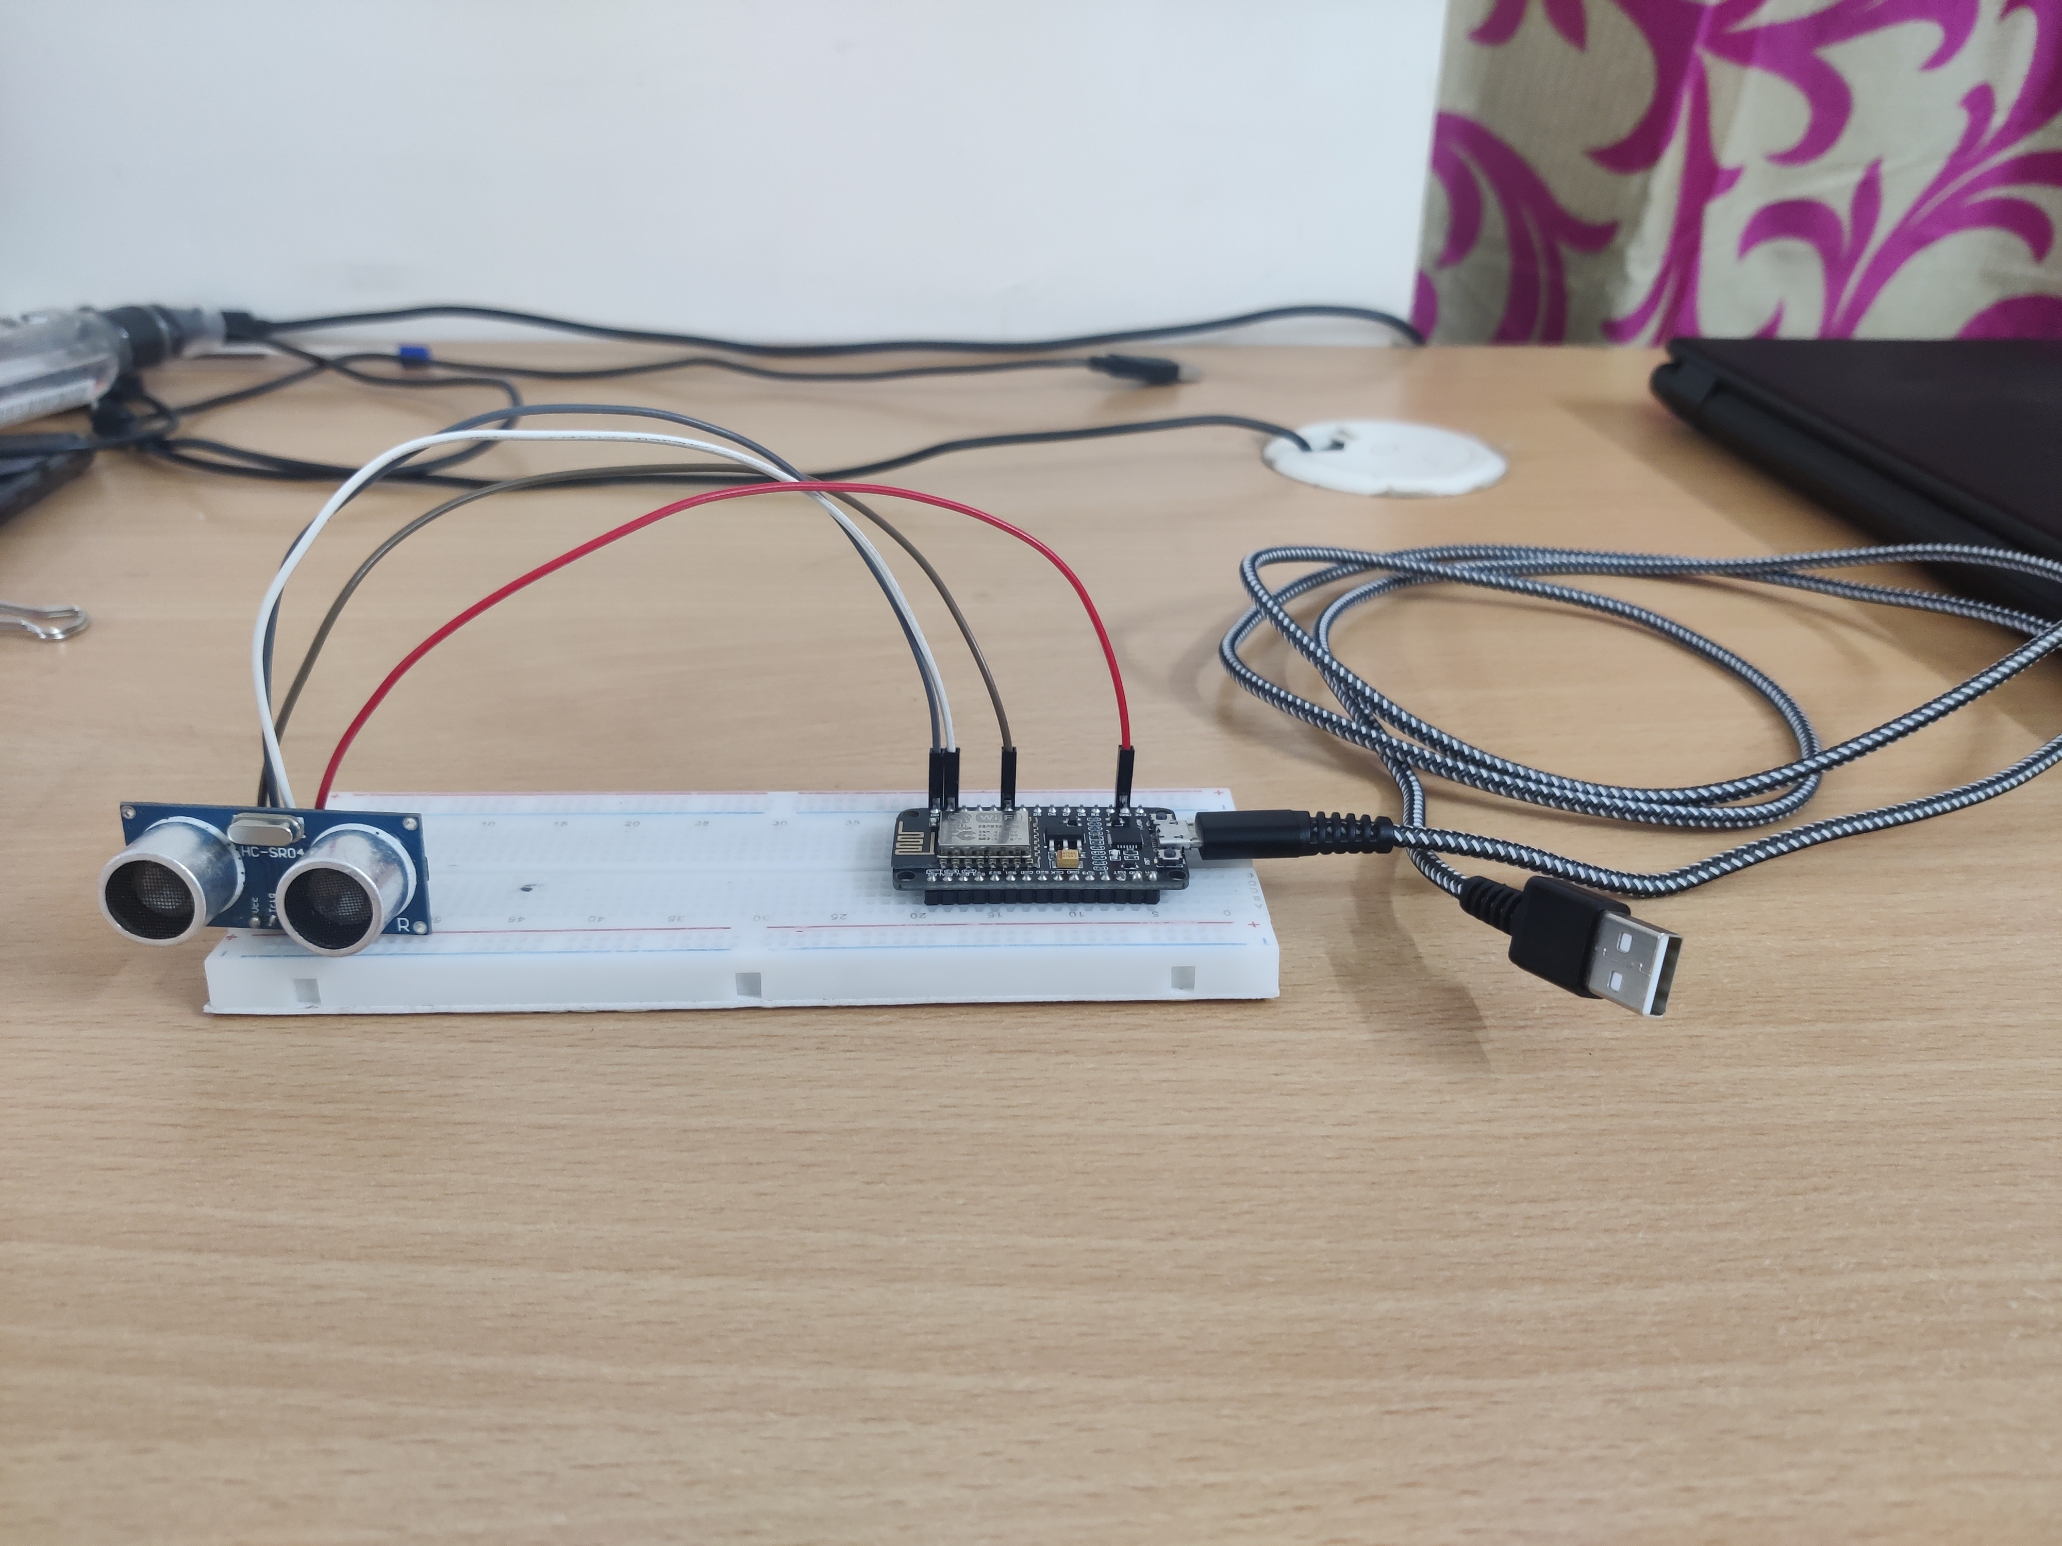
Hardware Prototype

Slide 11
Future Plan
In Future with infitrometer we can add ph sensor to calculate the ph value of water.
We can make Device as user friendly , then farmer can easily used by clicking one button on his smartphone.

Slide 12
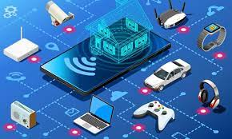
Thank You

